Slide 1
Testing Web Applications
CSE-477 Web Engineering
Dr. Awais Majeed

Slide 2
Outline
Introduction
Testing Levels
Testing Web Application – Challenges
Test Approaches
Test Scheme

Slide 3
Introduction
Web applications pose new challenges to quality assurance and testing
Diversity of software components is one of the major reasons
Testing is one of the most important instruments in the development of Web applications to achieve high-quality products that meet users’ expectations
Testing is an activity conducted to evaluate the quality of a product and to improve it by identifying defects and problems
If we run a program with the intent to find errors, then we talk about testing (Myers 1979).
We say that an error is present if the actual result from a test run does not comply with the expected result.
The expected result is specified, for example, in the requirements definition

Slide 4
Introduction
This approach assumes that requirement definition is complete.
In case of Web applications it is not possible, as requirements are defined over a period of time.
Consequently the goals, concerns, and expectations of the stakeholders are the basis of testing
Each deviation from the value typically expected by users is also considered an error.
A single test case describes a set of inputs, execution conditions and expected results, which are used to test a specific aspect of the object under test (IEEE standard 610.12-1990).

Slide 5
Introduction
Testing Quality
Behaviour is not the only aspect that needs to be tested to meet user requirements
It is also important to test the application whether it meets the quality requirements
Six principal categories of characteristics are – functionality, reliability, usability, efficiency, maintainability and portability
Test objectives
The main objective of testing is to find errors rather than showing their absence
A test run is successful if errors are detected, giving an insight into the problems

Slide 6
Test Levels
Unit tests: test the smallest testable units (classes, Web pages, etc.), independently of one another. Unit testing is done by the developer during implementation.
Integration tests: evaluate the interaction between distinct and separately tested units once they have been integrated. Integration tests are performed by a tester, a developer, or both jointly.
System tests: test the complete, integrated system. System tests are typically performed by a specialized test team.
Acceptance tests: evaluate the system in cooperation with or under the auspice of the client in an environment that comes closest to the production environment. Acceptance tests use real conditions and real data.
Beta tests: let friendly users work with early versions of a product with the goal to provide early feedback. Beta tests are informal tests (without test plans and test cases) which rely on the number and creativity of potential users.

Slide 7
Testing Web Application - Challenges
Errors in the content
Finding errors in the content is costly i.e. often requires proofreading
Meta-information about the content’s structuring and semantics or a reference system that supplies comparative values are often a prerequisite to be able to perform in-depth tests.
Hypertext structure
Ensure that pages are accessible through a hyperlink
All links have to point to existing pages, i.e., they mustn’t be broken.
Broken links represent frequent errors when statically pre-defined links become invalid

Slide 8
Testing Web Application - Challenges
Presentation & aesthetics
Presentation requirements are soft and difficult to test i.e. aesthetics
Tester should be able to clearly and objectively distinguish acceptable (and desired) behaviour from faulty behaviour.
multi-platform delivery
A large number of platforms and devices pose another challenge
Even if all devices are available, tester has to run each test case on each type of device
Use of simulators/emulators is not satisfactory as well

Slide 9
Testing Web Application - Challenges
Multi-linguality and usability
The major challenge is to recognize cultural interdependencies and consider them adequately in the test
i.e., different lengths of text messages in different languages which may result in layout difficulties.
Multi-disciplinarity of team
Teams often tend to avoid using a methodological approach to testing
Often knowledge about methods, technologies, and tools has to be acquired in the course of a project
Different points of view with regard to testing have to be consolidated.

Slide 10
Test Approaches
Various approaches are used for software project management
Agile approaches (extreme programming etc.) are being increasingly used in Web projects
Agile approaches focus on collaboration while conventional approaches focus on planning and project management

Slide 11
Test Approaches – Conventional approaches
Planning: defines the quality goals, the general testing strategy, the test plans for all test levels, the metrics and measuring methods, and the test environment.
Preparing: This step involves selecting the testing techniques and tools and specifying the test cases (including the test data).
Performing: This step prepares the test infrastructure, runs the test cases, and then documents and evaluates the results.
Reporting: This final step summarizes the test results and produces the test reports.

Slide 12
Test Approaches – Agile approaches
Team-base approach to problem solution with joint effort
Same applies to testing i.e., it is an integrated development activity.
Extreme programming (XP) practices influencing testing and quality assurance are:
  Pair programming: accelerates the exchange of knowledge between various roles and within the team.
    It also helps to detect errors early.
  An on-site customer: clarifies and takes action about requirements.
    Customer and tester collaboratively develop functional tests
  Continuous integration: ensures that small steps help minimize the risk of changes, and walks through all tests to continuously verify that the entire system is faultless.
  Test-first development: Tests are written before the code
    ensures that the “developer pair” thinks about the “what” before it implements the “how”.
    Automated test can help in integration

Slide 13
Test Scheme
Test dimensions
Every test has a defined goal,
  to check the correctness of an algorithm,
  to reveal security violations in a transaction,
  or to find style incompatibilities in a graphical representation.
Tests are described by required quality characteristics
  Correctness, security, compatibility
Tests are also based on test objects i.e., what needs to be tested
  Algorithms, transactions, representations.
Test objects are tested for required quality characteristics or objects are identified that affect a particular quality aspect
Test objects and quality characteristics form 2 dimensions
3rd dimension specifies at what phase or time of the software lifecycle the combination of the above two needs to be tested.

Slide 14
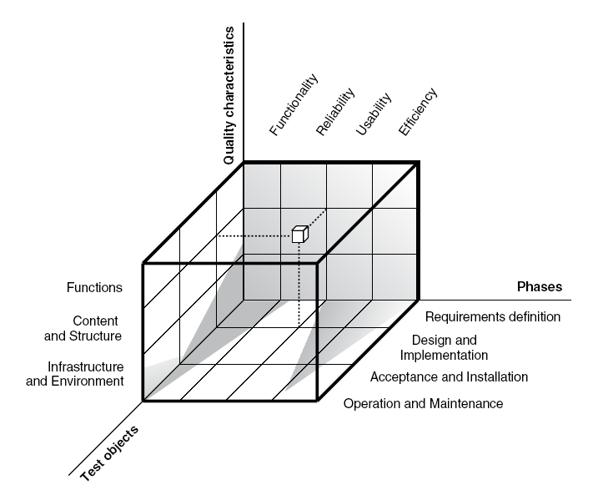
Test Scheme - II
Test scheme for Web applications

Slide 15
Self Study
Related topics of Chapter 7 (7.1 - 7.6) including:
  7.5.3 Example of using the test scheme
  7.6 Test methods and techniques

